Slide 1
Instruction Mix Analyzer
By Ranis Hamidullin
A tool for analyzing RISC-V instruction distributions

Slide 2
Why is This Useful?
To understand what types of instructions programs actually use.
2. Hardware designers use this to optimize CPU resources.
3. Compiler writers use this to improve code generation.

Slide 3
Process
1. Read each hex value from the file
2. Extract 7-bit opcode field
3. Map opcode to category (ALU, Memory, Branch, Control Flow, and Other)
4. Count and calculate percentages
5. Print and write the results

Slide 4
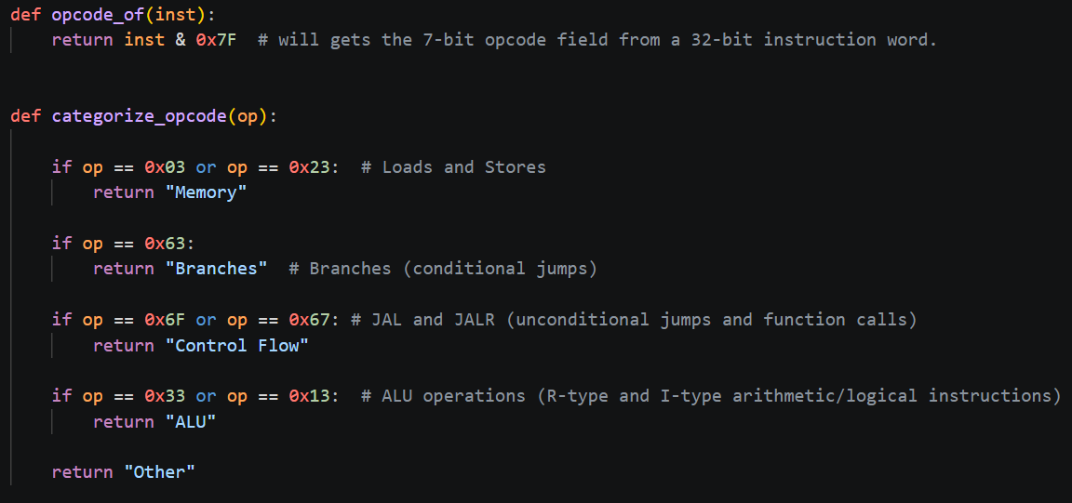
Core Logic

Slide 5
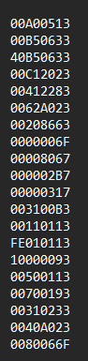
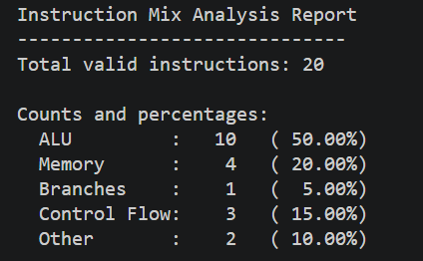
Small Instruction File (20)

Slide 6

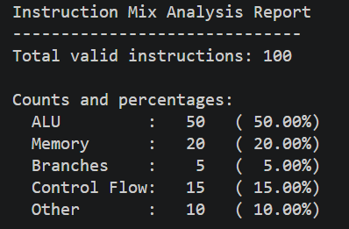

Large Instruction File (100)
•
•
•

Slide 7
Conclusion (Most to Least Common)
ALU operations (usually 45-50% of instructions)
2. Memory operations (usually 25-30%)
3. Branches (usually 10-15%)
4. Jumps/calls (usually 5%)

